Slide 1


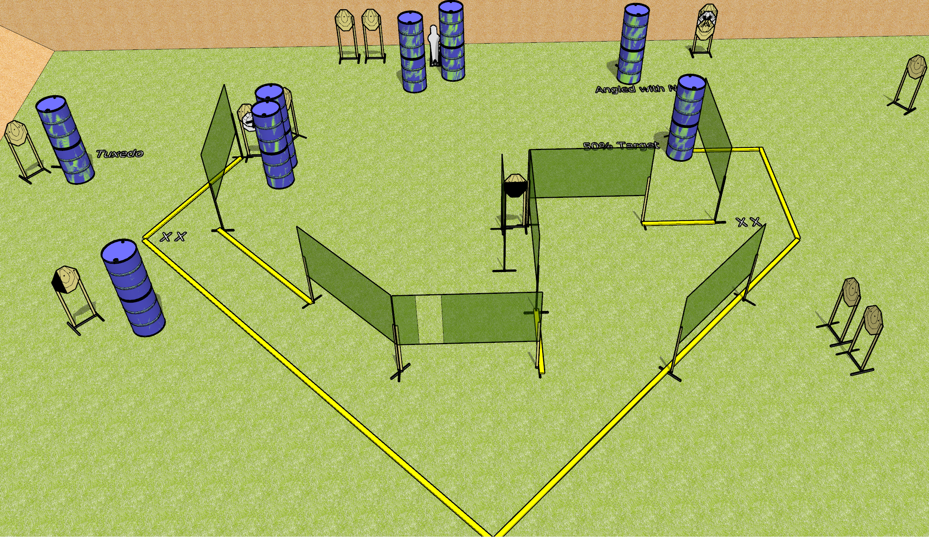
 | Dothan Gun Club – USPSA Match Flights of Fancy Course Designer : Drew Coleman
Round Count 31 15 ISPC 1 Pepper popper
Equipment List 3 medium fault lines 15 wall feet 1 left, 2 50% HC, 1 tuxedo

Slide 2
Flights of Fancy
Written Stage Briefing
Flights of Fancy is a 31 round, 155 point, Comstock field course. There are 15 IPSC targets and 1 mini popper. The best 2 hits on paper will score, and steel must fall to score. The start signal is audible.
Handgun start position is both feet on either set of X’s, wrists below belt. Handgun is loaded and holstered.
PCC start position is both feet on either set of X’s. Loaded carbine is held with both hands, stock on belt, safety on.
On start signal, engage targets as they become available from within the shooting area.

